Slide 1
Introduction to XML (Extensible Markup Language)
Bernardo Nugroho Yahya

Slide 2
Contents
XML (eXtensible Markup Language)
DTD (Document Type Definitions)
XSL (eXtensible Stylesheet Language)
XML with JSP
XFORM

Slide 3
What is XML
XML stands for eXtensible Markup Language.
A markup language is used to provide information about a document.
Tags are added to the document to provide the extra information.
HTML tags tell a browser how to display the document.
XML tags give a reader some idea what some of the data means.

Slide 4
What is XML Used For?
XML documents are used to transfer data from one place to another often over the Internet.
XML subsets are designed for particular applications.
One is RSS (Rich Site Summary or Really Simple Syndication ). It is used to send breaking news bulletins from one web site to another.
A number of fields have their own subsets. These include chemistry, mathematics, and books publishing.
Most of these subsets are registered with the W3Consortium and are available for anyone’s use.

Slide 5
Advantages of XML
XML is text (Unicode) based.
Takes up less space.
Can be transmitted efficiently.
One XML document can be displayed differently in different media.
Html, video, CD, DVD,
You only have to change the XML document in order to change all the rest.
XML documents can be modularized. Parts can be reused.

Slide 6
Example of an HTML Document
<html>
<head><title>Example</title></head.
<body>
<h1>This is an example of a page.</h1>
<h2>Some information goes here.</h2>
</body>
</html>

Slide 7
Example of an XML Document
<?xml version=“1.0”/>
<address>
<name>Alice Lee</name>
<email>alee@aol.com</email>
<phone>212-346-1234</phone>
<birthday>1985-03-22</birthday>
</address>

Slide 8
Difference Between HTML and XML
HTML tags have a fixed meaning and browsers know what it is.
XML tags are different for different applications, and users know what they mean.
HTML tags are used for display.
XML tags are used to describe documents and data.

Slide 9
XML Rules
Tags are enclosed in angle brackets.
Tags come in pairs with start-tags and end-tags.
Tags must be properly nested.
<name><email>…</name></email> is not allowed.
<name><email>…</email><name> is.
Tags that do not have end-tags must be terminated by a ‘/’.
<br /> is an html example.

Slide 10
More XML Rules
Tags are case sensitive.
<address> is not the same as <Address>
XML in any combination of cases is not allowed as part of a tag.
Tags may not contain ‘<‘ or ‘&’.
Tags follow Java naming conventions, except that a single colon and other characters are allowed. They must begin with a letter and may not contain white space.
Documents must have a single root tag that begins the document.

Slide 11
Encoding
XML (like Java) uses Unicode to encode characters.
Unicode comes in many flavors. The most common one used in the West is UTF-8.
UTF-8 is a variable length code. Characters are encoded in 1 byte, 2 bytes, or 4 bytes.
The first 128 characters in Unicode are ASCII.
In UTF-8, the numbers between 128 and 255 code for some of the more common characters used in western Europe, such as ã, á, å, or ç.
Two byte codes are used for some characters not listed in the first 256 and some Asian ideographs.
Four byte codes can handle any ideographs that are left.
Those using non-western languages should investigate other versions of Unicode.

Slide 12
Well-Formed Documents
An XML document is said to be well-formed if it follows all the rules.
An XML parser is used to check that all the rules have been obeyed.
Recent browsers (e.g., IE, Chrome, etc.) come with XML parsers.
Parsers are also available for free download over the Internet. One is Xerces, from the Apache open-source project.
Java (from Java 1.4) also supports an open-source parser.

Slide 13
XML Example Revisited
<?xml version=“1.0”/>
<address>
<name>Alice Lee</name>
<email>alee@aol.com</email>
<phone>212-346-1234</phone>
<birthday>1985-03-22</birthday>
</address>
Markup for the data aids understanding of its purpose.
A flat text file is not nearly so clear.
Alice Lee
alee@aol.com
212-346-1234
1985-03-22
The last line looks like a date, but what is it for?

Slide 14
Expanded Example
<?xml version = “1.0” ?>
<address>
<name>
<first>Alice</first>
<last>Lee</last>
</name>
<email>alee@aol.com</email>
<phone>123-45-6789</phone>
<birthday>
<year>1983</year>
<month>07</month> <day>15</day>
</birthday>
</address>

Slide 15
XML Files are Trees
address
name
email
phone
birthday
first
last
year
month
day

Slide 16
XML Trees
An XML document has a single root node.
The tree is a general ordered tree.
A parent node may have any number of children.
Child nodes are ordered, and may have siblings.
Preorder traversals are usually used for getting information out of the tree.

Slide 17
Validity
A well-formed document has a tree structure and obeys all the XML rules.
A particular application may add more rules in either a DTD (document type definition) or in a schema.
Many specialized DTDs and schemas have been created to describe particular areas.
These range from disseminating news bulletins (RSS) to chemical formulas.
DTDs were developed first, so they are not as comprehensive as schema.

Slide 18
Document Type Definitions
A DTD describes the tree structure of a document and something about its data.
There are two data types, PCDATA and CDATA.
PCDATA is parsed character data.
CDATA is character data, not usually parsed.
A DTD determines how many times a node may appear, and how child nodes are ordered.

Slide 19
DTD for address Example
<!ELEMENT address (name, email, phone, birthday)>
<!ELEMENT name (first, last)>
<!ELEMENT first (#PCDATA)>
<!ELEMENT last (#PCDATA)>
<!ELEMENT email (#PCDATA)>
<!ELEMENT phone (#PCDATA)>
<!ELEMENT birthday (year, month, day)>
<!ELEMENT year (#PCDATA)>
<!ELEMENT month (#PCDATA)>
<!ELEMENT day (#PCDATA)>

Slide 20
Schemas
Schemas are themselves XML documents.
They were standardized after DTDs and provide more information about the document.
They have a number of data types including string, decimal, integer, boolean, date, and time.
They divide elements into simple and complex types.
They also determine the tree structure and how many children a node may have.

Slide 21
Schema for First address Example
<?xml version="1.0" encoding="ISO-8859-1" ?>
<xs:schema xmlns:xs="http://www.w3.org/2001/XMLSchema">
<xs:element name="address">
<xs:complexType>
<xs:sequence>
<xs:element name="name" type="xs:string"/>
<xs:element name="email" type="xs:string"/>
<xs:element name="phone" type="xs:string"/>
<xs:element name="birthday" type="xs:date"/>
</xs:sequence>
</xs:complexType>
</xs:element>
</xs:schema>

Slide 22
Explanation of Example Schema
<?xml version="1.0" encoding="ISO-8859-1" ?>
ISO-8859-1, Latin-1, is the same as UTF-8 in the first 128 characters.
<xs:schema xmlns:xs="http://www.w3.org/2001/XMLSchema">
www.w3.org/2001/XMLSchema contains the schema standards.
<xs:element name="address">
<xs:complexType>
This states that address is a complex type element.
<xs:sequence>
This states that the following elements form a sequence and must come in the order shown.
<xs:element name="name" type="xs:string"/>
This says that the element, name, must be a string.
<xs:element name="birthday" type="xs:date"/>
This states that the element, birthday, is a date. Dates are always of the form yyyy-mm-dd.

Slide 23
XSLT Extensible Stylesheet Language Transformations
XSLT is used to transform one xml document into another, often an html document.
The Transform classes are now part of Java (from Java 1.4).
A program is used that takes as input one xml document and produces as output another.
If the resulting document is in html, it can be viewed by a web browser.
This is a good way to display xml data.

Slide 24
example.xml
<?xml version="1.0"?>
<?xml-stylesheet type="text/xsl" href="example.xsl"?>
<Article>
<Title>My Article</Title>
<Authors>
<Author>Mr. Foo</Author>
<Author>Mr. Bar</Author>
</Authors>
<Body>This is my article text.</Body>
</Article>

Slide 25
example.xsl
<?xml version="1.0"?>
<xsl:stylesheet version="1.0" xmlns:xsl="http://www.w3.org/1999/XSL/Transform">
<xsl:output method="text"/>
<xsl:template match="/">
Article - <xsl:value-of select="/Article/Title"/>
Authors: <xsl:apply-templates select="/Article/Authors/Author"/>
</xsl:template>
<xsl:template match="Author">
- <xsl:value-of select="." />
</xsl:template>
</xsl:stylesheet>

Slide 26
XML with JSP (1/5)
When you send XML data via HTTP, it makes sense to use JSP to handle incoming and outgoing XML documents for example RSS documents.
As an XML document is merely a bunch of text, creating one through a JSP is no more difficult than creating an HTML document.

Slide 27
XML with JSP (2/5)
You can send XML content using JSPs the same way you send HTML. The only difference is that you must set the content type of your page to text/xml. To set the content type, use the <%@page%> tag, like this:
<%@ page contentType="text/xml" %>

Slide 28
XML with JSP (3/5)
Xerces is basically a parser for parsing and printing an XML document, to generate XML from arbitrary data.
Xalan-Java is an XSLT processor for transforming XML documents into HTML, text, or other XML document types.
XSLT (Extensible Stylesheet Language Transformations) has API and implementation library
In addition, it has serializer.jar and xml-apis.jar for the readability and write-ability of standard XML.

Slide 29
XML with JSP (4/5)
Before you proceed with XML processing using JSP, you would need to copy following two XML and XPath related libraries into your <Tomcat Installation Directory>\lib:
XercesImpl.jar: Download it from http://www.apache.org/dist/xerces/j/
xalan.jar: Download it from http://xml.apache.org/xalan-j/index.html
http://www.apache.org/dist/xalan/xalan-j/binaries/

Slide 30
XML with JSP (5/5)
XSTL API
javax.servlet.jsp.jstl-api-1.2.1.jar
http://search.maven.org/#browse|707331597
XSTL Implementation
javax.servlet.jsp.jstl-1.2.1.jar
http://search.maven.org/#browse|-1002239620
Put also:
serializer.jar
xml-apis.jar

Slide 31
This example…
This example shows how to read XML using JSP. In addition, it uses the JSP Standard Tag Library (the previous version of JSP).
This example introduces 2 additional files
XML (eXtensible Markup Language)
XSL (eXtensible Stylesheet Language)
This example consists of four (4) files.
books.xml (it is the data)
main.jsp (it is the jsp file to read the data)
style.xsl (it is the xsl file to transform the xml file for readability format)
Main2.jsp (improved version)

Slide 32
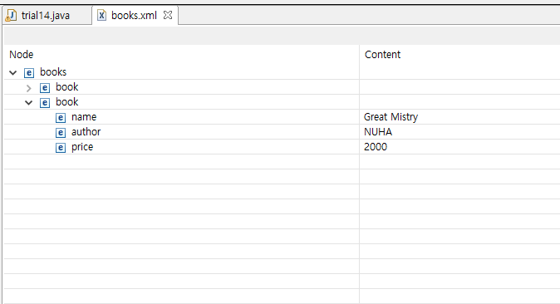
books.xml
<books>
<book>
<name>Padam History</name>
<author>ZARA</author>
<price>100</price>
</book>
<book>
<name>Great Mistry</name>
<author>NUHA</author>
<price>2000</price>
</book>
</books>

Slide 33
main.jsp
<%@ taglib prefix="c" uri="http://java.sun.com/jsp/jstl/core" %>
<%@ taglib prefix="x" uri="http://java.sun.com/jsp/jstl/xml" %>
<html>
<head>
<title>JSTL x:parse Tags</title>
</head>
<body>
<h3>Books Info:</h3>
<c:import var="bookInfo" url="/books.xml"/>
<x:parse xml="${bookInfo}" var="output"/>
<b>The title of the first book is</b>:
<x:out select="$output/books/book[1]/name" />
<br>
<b>The price of the second book</b>:
<x:out select="$output/books/book[2]/price" />
</body>
</html>

Slide 34
style.xsl
<?xml version="1.0"?>
<xsl:stylesheet xmlns:xsl=
"http://www.w3.org/1999/XSL/Transform" version="1.0">
<xsl:output method="html" indent="yes"/>
<xsl:template match="/">
<html>
<body>
<xsl:apply-templates/>
</body>
</html>
</xsl:template>
<xsl:template match="books">
<table border="1" width="100%">
<xsl:for-each select="book">
<tr>
<td>
<i><xsl:value-of select="name"/></i>
</td>
<td>
<xsl:value-of select="author"/>
</td>
<td>
<xsl:value-of select="price"/>
</td>
</tr>
</xsl:for-each>
</table>
</xsl:template>
</xsl:stylesheet>

Slide 35
main2.jsp
<%@ taglib prefix="c" uri="http://java.sun.com/jsp/jstl/core" %>
<%@ taglib prefix="x" uri="http://java.sun.com/jsp/jstl/xml" %>
<html>
<head>
<title>JSTL x:transform Tags</title>
</head>
<body>
<h3>Books Info:</h3>
<c:set var="xmltext">
<books>
<book>
<name>Padam History</name>
<author>ZARA</author>
<price>100</price>
</book>
<book>
<name>Great Mistry</name>
<author>NUHA</author>
<price>2000</price>
</book>
</books>
</c:set>
<c:import url="/style.xsl" var="xslt"/>
<x:transform xml="${xmltext}" xslt="${xslt}"/>
</body>
</html>

Slide 36
JSTL (JavaServer Pages Tag Library)
The JavaServer Pages Standard Tag Library (JSTL) is a collection of useful JSP tags which encapsulates core functionality common to many JSP applications.
The JSTL tags can be classified, according to their functions, into following JSTL tag library groups that can be used when creating a JSP page:
Core Tags
Formatting tags
SQL tags
XML tags
JSTL Functions

Slide 37
JSTL Core
There are following Core JSTL Tags:
Tag | Description
<c:out > | Like <%= ... >, but for expressions.
<c:set > | Sets the result of an expression evaluation in a 'scope'
<c:remove > | Removes a scoped variable (from a particular scope, if specified).
<c:catch> | Catches any Throwable that occurs in its body and optionally exposes it.
<c:if> | Simple conditional tag which evalutes its body if the supplied condition is true.
<c:choose> | Simple conditional tag that establishes a context for mutually exclusive conditional operations, marked by <when> and <otherwise>
<c:when> | Subtag of <choose> that includes its body if its condition evalutes to 'true'.
<c:otherwise > | Subtag of <choose> that follows <when> tags and runs only if all of the prior conditions evaluated to 'false'.
<c:import> | Retrieves an absolute or relative URL and exposes its contents to either the page, a String in 'var', or a Reader in 'varReader'.
<c:forEach > | The basic iteration tag, accepting many different collection types and supporting subsetting and other functionality .
<c:forTokens> | Iterates over tokens, separated by the supplied delimeters.
<c:param> | Adds a parameter to a containing 'import' tag's URL.
<c:redirect > | Redirects to a new URL.
<c:url> | Creates a URL with optional query parameters

Slide 38
JSTL XML
The JSTL XML tags provide a JSP-centric way of creating and manipulating XML documents. Following is the syntax to include JSTL XML library in your JSP.
The JSTL XML tag library has custom tags for interacting with XML data. This includes parsing XML, transforming XML data, and flow control based on XPath expressions.

Slide 39
JSTL XML
Tag | Description
<x:out> | Like <%= ... >, but for XPath expressions.
<x:parse> | Use to parse XML data specified either via an attribute or in the tag body.
<x:set > | Sets a variable to the value of an XPath expression.
<x:if > | Evaluates a test XPath expression and if it is true, it processes its body. If the test condition is false, the body is ignored.
<x:forEach> | To loop over nodes in an XML document.
<x:choose> | Simple conditional tag that establishes a context for mutually exclusive conditional operations, marked by <when> and <otherwise>
<x:when > | Subtag of <choose> that includes its body if its expression evalutes to 'true'
<x:otherwise > | Subtag of <choose> that follows <when> tags and runs only if all of the prior conditions evaluated to 'false'
<x:transform > | Applies an XSL transformation on a XML document
<x:param > | Use along with the transform tag to set a parameter in the XSLT stylesheet

Slide 40
main.jsp
JSTL Core Library
<%@ taglib prefix="c" uri="http://java.sun.com/jsp/jstl/core" %>
<%@ taglib prefix="x" uri="http://java.sun.com/jsp/jstl/xml" %>
<html>
<head>
<title>JSTL x:parse Tags</title>
</head>
<body>
<h3>Books Info:</h3>
<c:import var="bookInfo" url="/books.xml"/>
<x:parse xml="${bookInfo}" var="output"/>
<b>The title of the first book is</b>:
<x:out select="$output/books/book[1]/name" />
<br>
<b>The price of the second book</b>:
<x:out select="$output/books/book[2]/price" />
</body>
</html>
JSTL XML Library
JSTL Core Tag
JSTL XML Tag
JSTL XML Tag
JSTL XML Tag

Slide 41
style.xsl
<?xml version="1.0"?>
<xsl:stylesheet xmlns:xsl=
"http://www.w3.org/1999/XSL/Transform" version="1.0">
<xsl:output method="html" indent="yes"/>
<xsl:template match="/">
<html>
<body>
<xsl:apply-templates/>
</body>
</html>
</xsl:template>
<xsl:template match="books">
<table border="1" width="100%">
<xsl:for-each select="book">
<tr>
<td>
<i><xsl:value-of select="name"/></i>
</td>
<tda>
<xsl:value-of select="author"/>
</td>
<td>
<xsl:value-of select="price"/>
</td>
</tr>
</xsl:for-each>
</table>
</xsl:template>
</xsl:stylesheet>
Match with the whole document of XML
Match with XML tag
Match with XML tag
Match with XML tag
Match with XML tag

Slide 42
XML Programming – XForms

Slide 43
Contents
XForms Introduction
Current development of XForms
Example of XForms

Slide 44
XForms Background
HTML Forms were never “designed” by application architects
HTML Forms did not take advantage of XML and CSS standards
Next generation of web forms processing
Reached final “recommended” status in 2006
Leverage expanded use of CSS
Based on W3C XML standards
XML Schemas
XML Schema datatypes
XPath
Much less procedural JavaScript

Slide 45
Model Driven
XForms
Application
XForms enables the developer to reuse business rules encapsulated in XML Schemas (xsd) and XML Transforms (xslt)
XForms reduces duplication and ensures that a change in the underlying business logic does not require rewriting in another language
XML
Schema
Meta Data
Registry

Slide 46
Model-View-Controller
XForms uses a variation of the model-view-controller (MVC) design pattern
The model has no user interface concepts
The control layer moves data to and from the model
View (Presentation)
Control
Model

Slide 47
View and Model are Trees
View (Presentation)
The view is a tree of a presentation data element
Models are comprised of one or more trees
XForms supplies the control layer that moves data elements to and from the model
Users don’t have to worry about moving things to and from the screen
Control
Model

Slide 48
Separation of Concerns
<head>
</head>
Business Model
(non-visible)
<html>
</html>
XForms Model
<body>
</body>
Presentation
Form controls
Model is in the header (non-visual section)
Visual components are in the body (presentation)

Slide 49
XHTML Presentation is a Tree
HTML
head
body
h1
title
style
p
form
form
meta
…
fieldset
fieldset
label
input
label
input
Both the model and the views are trees of data elements

Slide 50
Model is Also A Tree
HTML
head
xf:model
title
style
Person
Organization
meta
…
Name
Address
first
last
street
city
state
zip
Both the model and the views are trees of data elements

Slide 51
Models and View Are Linked with "Bind"
HTML
head
xf:model
body
Person
form
Name
fieldset
label
label
first
last
input
<bind>
input
Both the model and the views are trees of data elements

Slide 52
Just Do The Right Thing
HTML
head
xf:model
body
Person
form
PersonCurrentOnTaxes type="xs:boolean"
fieldset
label
PersonBirthDate type="xs:date"
label
input
input
<bind>
Data types from the model just do the right thing
Boolean variables become checkboxes
Dates have date selectors

Slide 53
Structure of a XForms File
XForms tags are just XML tags imbedded in a standard XHTML file with a different namespace
Most HTML form tags are exactly the same but some attributes have been promoted to be full elements
Namespaces
CSS Imports (View)
Model
Constraints (Bindings)
UI (View)
Submit
MyForm.xhtml

Slide 54

Device Independence
Abstract user interface controls lead to intent-based authoring of the user interface
An XForms application can target many different devices
XForms can be deployed to a range of accessing devices

Slide 55
HTML to XForms Conversions
HTML Form | XForms | Note
<input type="text"> | <input>
<input type="password"> | <secret>
<input type="textarea"> | <textarea>
<input type="hidden"> |  | default – values displayed only when controls are bound
<input type="checkbox"> | <input> | bound to xs:boolean
<input type="radio"> | <select1>
<select> | <select>
<input type="submit"> | <submit>
<input type="reset"> | <trigger> | with handler <reset>
<input type="file"> | <upload>
<input type="image"> | <trigger> | with image <label>
<input type="button"> | <trigger>
Note: Conversion programs are available if you don’t overuse JavaScripts

Slide 56
Old style HTML Form
<form action="http://example.com/submit" method="post">
<label>
<input type="radio" name="as" value="cash"/> Cash
</label>
…
</form>

Slide 57
XForms Example (1)
<xforms:model>
<xforms:submitInfo action="http://examples.com/submit" id="submit"/>
</xforms:model>

Slide 58
Step-by-step
Download the source from this link
http://www.agencexml.com/xsltforms
Extract all the files
Change the root folder into a simple name. (for example: ”xsltforms”)
Make a new folder in the tomcat folder
(for example: create a folder named ”xslttrial”)
Move the folder ”xsltforms” into the folder ”xslttrial”
Start your tomcat
Open Internet Explorer or Chrome
http://localhost:8080/xslttrial/

Slide 59
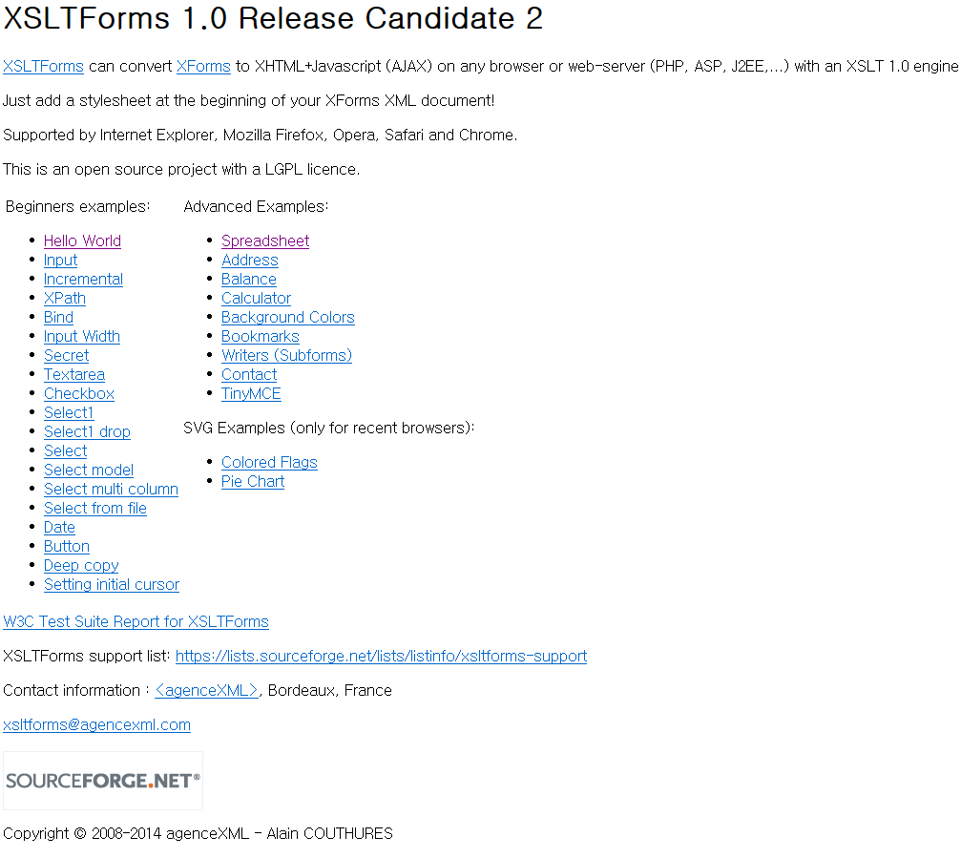

Slide 60
Hello World in XForms
<?xml-stylesheet href="xsltforms/xsltforms.xsl" type="text/xsl"?>
<?xsltforms-options debug="yes"?>
<html xmlns="http://www.w3.org/1999/xhtml" xmlns:xf="http://www.w3.org/2002/xforms">
<head>
<title>Hello World in XForms</title>
<xf:model>
<xf:instance>
<data xmlns=""> <PersonGivenName/> </data>
</xf:instance>
</xf:model>
</head>
<body>
<p>Type your first name in the input box. <br/>
If you are running XForms, the output should be displayed in the output area.</p>
<xf:input ref="PersonGivenName" incremental="true">
<xf:label>Please enter your first name: </xf:label>
</xf:input>
<br />
<xf:output value="concat('Hello ', PersonGivenName, '. We hope you like XForms!')">
<xf:label>Output: </xf:label>
</xf:output>
</body>
</html>
Model

Slide 61
Summary
XML (eXtensible Markup Language)
DTD (Document Type Definitions)
XSL (eXtensible Stylesheet Language)
XML with JSP
Using XForms, new data can be requested and used to update the form while it is running, like using XMLHttpRequest/AJAX except without scripting
It is able to combine with JSP with additional codes

Slide 62
References
Elliotte Rusty Harold, Processing XML with Java, Addison Wesley, 2002.
Elliotte Rusty Harold and Scott Means, XML Programming, O’Reilly & Associates, Inc., 2002.
W3Schools Online Web Tutorials, http://www.w3schools.com.
Carol Wolf ppt file (Computer Science Department, Pace University)
https://developer.mozilla.org/en-US/docs/XSLT_in_Gecko/Basic_Example
http://www.tutorialspoint.com/jsp/jsp_xml_data.htm
www.danmccreary.com/presentations/XForms.ppt

